Slide 1
Inference CA
Bama Politics Dataset
Sruti Jain
2017.10.2

Slide 2
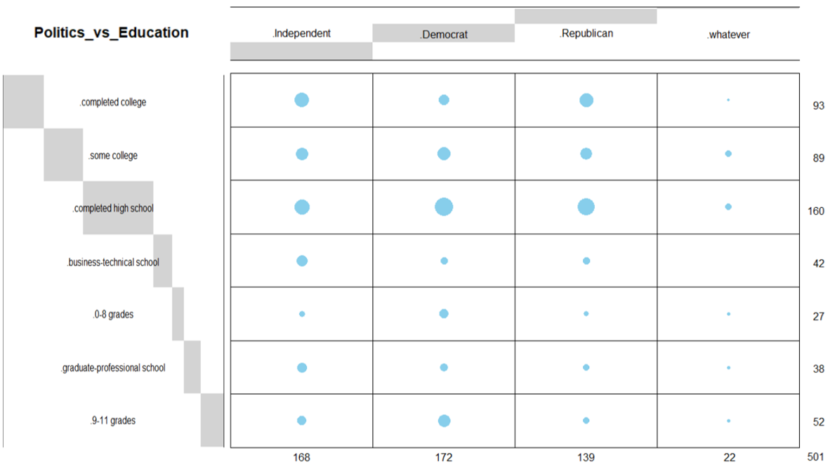
Introduction
Data: The survey of topics - education, ratings and images of political parties.
Rows: Education level - 7 groups
Columns: Political Parties – 4 groups
Research Question
How education is related to the choice of political parties?

Slide 3
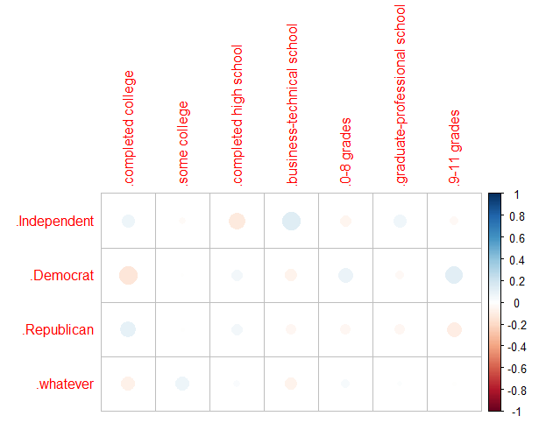
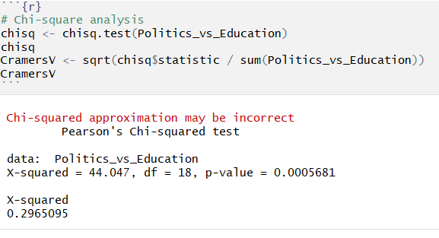
Results (1/5): Correlation plot

Slide 4
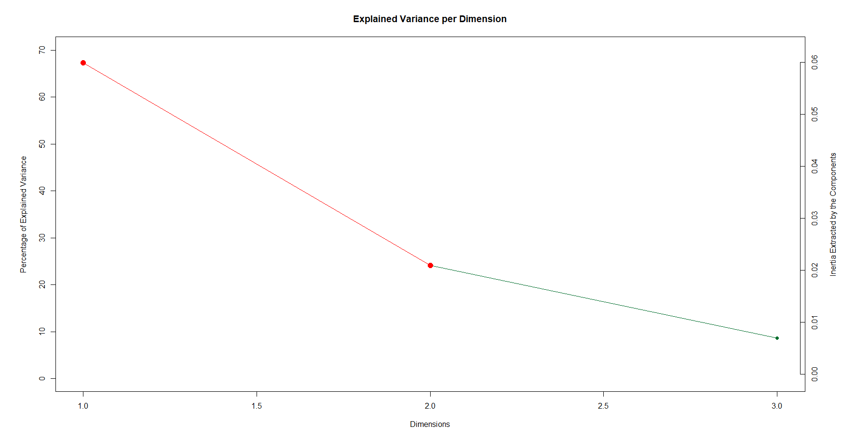
Results (2/5): Scree plot

Slide 5
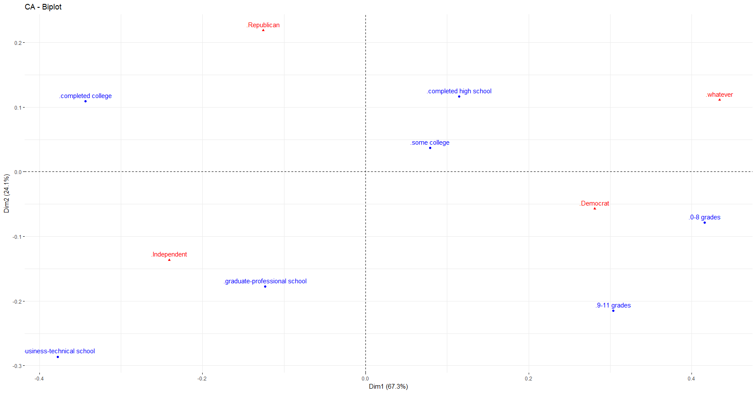
Results (3/5): Biplot for Factor Score

Slide 6

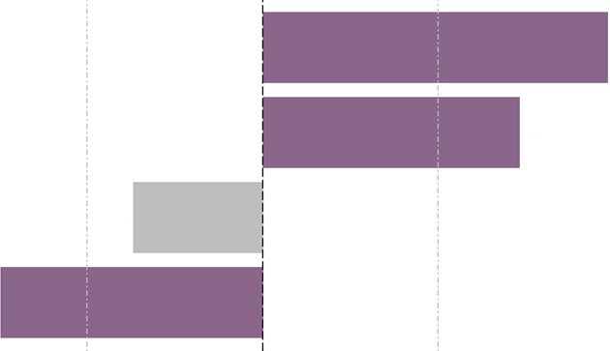

Results (4/5): Bootstrap ratios
Democrat
Whatever
Republican
Republican
Independent
Whatever
Democrat
Independent

Slide 7
Results (5/5): Correlation circle

Slide 8
Conclusion
Component 1
Row: Normal versus High Memory group
Column: Normal versus High Memory scores
Component 2
Column: Spatial versus other memory types
Distinguishes questions relating to spatial memory versus other memory types. Also shows negative correlation between spatial and future memory ratings.

Slide 9
Questions or comments?

